Slide 1
The Best Business Development Platform for All Organization

Slide 2
Human Rights
Immigrants & Refugees
Property Production
Advocacy
Agriculture & Food Security
History & Preservation
Corporation
Association
Government
NGO
Company
Firm
Business
Operation
Agency
Trust
Project
Club
Alliance
Convention
Guild
Fellowship
Union
Conference
Alumni
Consortium
League
Federation
Affiliation
Authority
Party
Taxes
Real Estate
Retail
Residential
Commercial
Financial Services
Hospitality
Airlines
Entertainment
Mass Media
Interactive Media
Transportation
Telecommunications
Aerospace
Defense
Protect
Security
Civil
Animals
Art & Culture
Children & Youth
Democracy & Governance
Disabilities
Economy Security
Environment Financial Services
Health & Human Services
Homeless & Housing
Who should use the IBN Platform?
ORGANIZATION
University
Education
Charities
School
University
Foundation
Volunteer
Donate
Fundraise
Childcare
Disabilities
Activities
Programs
Medical & Health
Autism Social Services
Support
Community
Museum

Slide 3
Alliance
Convention
Guild
Club
Fellowship
Affiliation
Union
ASSOCIATION
Federation
Conference
League
Alumni
Consortium

Slide 4
ASSOCIATION
CLUB

Slide 5
ASSOCIATION
Member
Member
Member
Member Business
Club
Member Business
Member Business
Join
Join
Join
Network 1
Your Network
Join
Join
Member Business
Member Business
Member
Create a Network
Member
Your Business
You

Slide 6
ASSOCIATION
Club
Network
1
Your
Network
Create a Network
Your Business
You

Slide 7
ASSOCIATION
Join
Join
Network
1
Join
Club
Your
Network
Network
4
Member Network
Join
Create a Network
Your Business
You
Create a Network
Join
Network
5
Member Network
Network
3
Network
2
Your Network
Member Network

Slide 8
Member
Member
Join
Join
Member
Join
Member
Join
Schoolmate
Your Group
Join
Member
Join
Member
Join
Join
Create
a Group
Member
Member
You

Slide 9
Schoolmate
Your Group
Member
Member
Join
Join
Member
Create a
Group
Member
Join
Join
Schoolmate
Your Group
You
Join
Member
Join
Member
Join
Join
Create
a Group
Member
Member
You

Slide 10
Join
Join
Join
Join
Member Group
Business
Join
Join
Schoolmate
Your Group
Social
Your Group
Member Group
Hobby / Interest
Create a
Group
Join
Create a
Group
Join
You
Join
Create a
Group
Create a
Group
Sports
Your Group
Member Group
Community
Travel
Buddy
Your Group

Slide 11
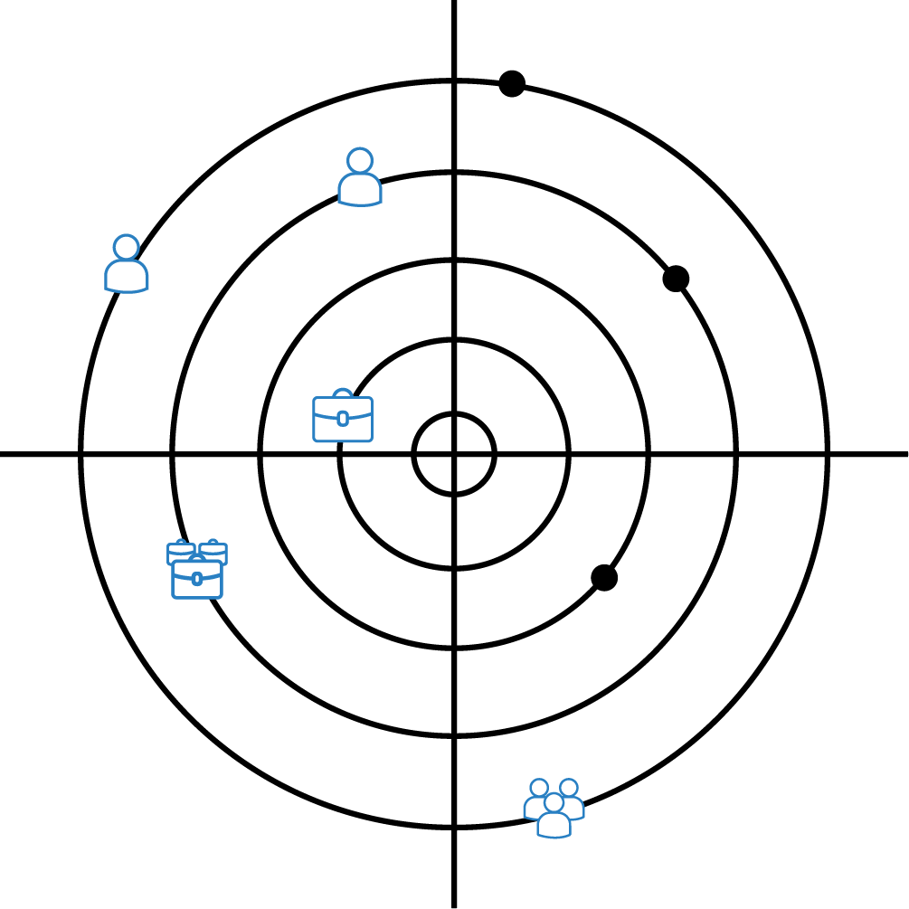
RADAR
Monitor those who you are interest to know about.

Slide 12
Mind Map
10
Individual
2
Group
Your Radar
Monitor
1
30
Business
3
Network
You
Your Business
Create a Business
2
Create Groups
Join
Create Networks
Join
3
3
3
6
Your Groups
Members’ Groups
Your Networks
Members’ Networks
Join
Join
Join
Join
30
60
150
300
Members
Members
Members Business
Members Business

Slide 13
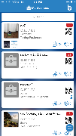
Your Network
Member’s Business
Mind Map
25
My Business
Create Networks
Join
100
Your
Business
25
Your Radar
1
Member’s Network
Member’s Business
100
50
Your
Business
Join
You
25
Your Group and Member’s Group
20
Join
50
50
25

Slide 14
Members
Mind Map
Your Group
15
My Group
Join
Create
Groups
5
Your Radar
1
10
Member’s Group
Members
22
Your Business
You
10
Join
Join
30
20

Slide 15
Mind Map
Your Business
My Network
Create Networks
Join
25
25
50
50
100
25
Member’s Network
Member’s Network
25
50
100

Slide 16
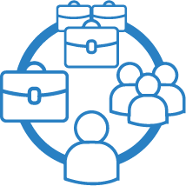
Mind Map
Monitor Member’s Personal Profile, Business, Network and Group.
Individual
10
My Radar
Group
2
Monitor
45
30
Business
1st Radar
3
Network
3
Individual
You
2
Group
Monitor
Monitor
Your Business
8
Business
22
2nd Radar
18
5
Network
1
Individual
Your Group and Member’s Group
20
3
Group
Monitor
25
15
Business
3rd Radar
6
Network

Slide 17
FEATURES
New Features
CHAT
INBOX
HELP
FAVOURITES
SETTINGS

Slide 18
CHAT
When you texting to members Personal Profile.
Members text you back.
Member send to your PERSONAL chat.
Texting…
Member
Your IBN App
You
Member
Your Group
Message Received
Member
Your Business
Member
Your Network
Member

Slide 19
CHAT
When you texting to Group,
everyone received.
Group members text back,
Everyone received too.
Member send to your GROUP chat.
Texting…
Member
Your IBN App
You
Member
Your Group
Message Received
Member
Your Business
Member
Your Network
Member

Slide 20
CHAT
Members text back to your Business Profile.
When you texting to members Business Profile.
Member send to your BUSINESS chat.
Texting…
Member
Your IBN App
You
Member
Your Group
Message Received
Member
Your Business
Member
Your Network
Member

Slide 21
CHAT
Members text back to your Network Profile.
When you texting to members Network Profile.
Member send to your NETWORK chat.
Texting…
Member
Your IBN App
You
Member
Your Group
Message Received
Member
Your Business
Member
Your Network
Member

Slide 22
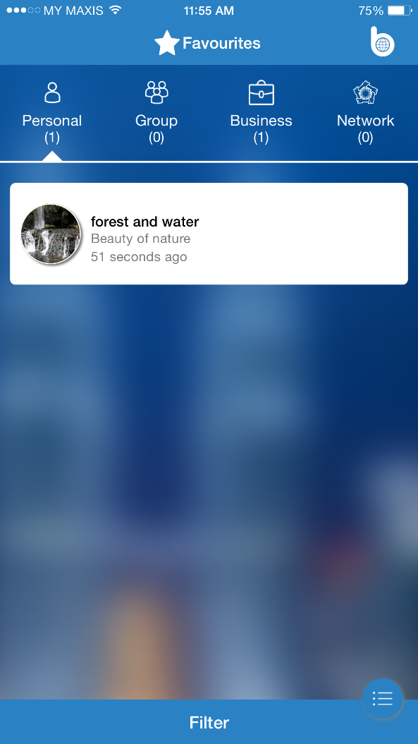
FAVOURITES
Favourites View

Slide 23
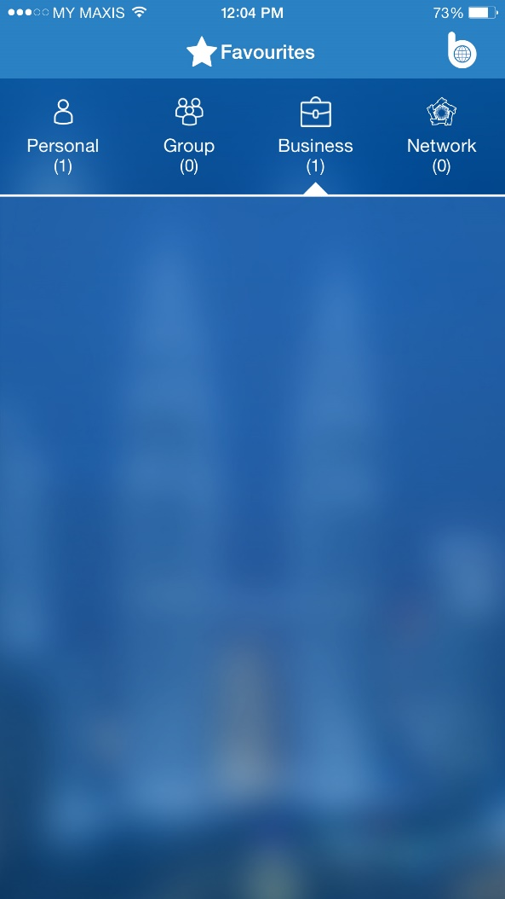
FAVOURITES
Favourites View
Join
Join
Network
1
Join
Your
Network
Network
4
Member Network
Join
Create a Network
Your Business
You
Looking for the
members profile…
Create a Network
Join
Network
5
Member Network
Network
3
Network
2
Your Network
Member Network

Slide 24
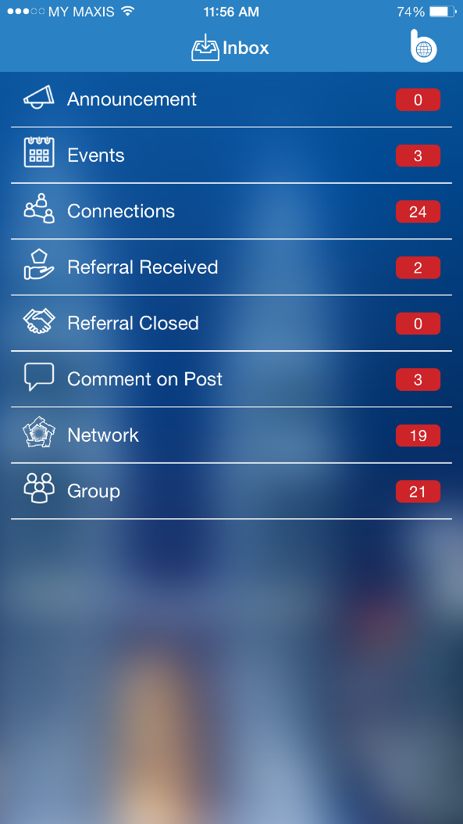
INBOX
Inbox View

Slide 25
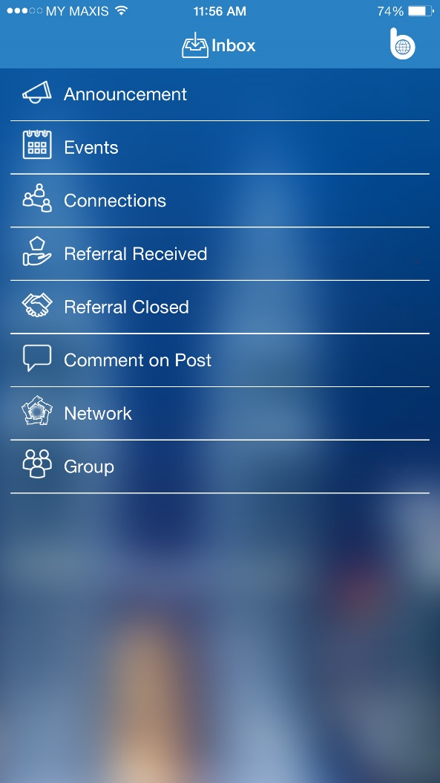
Announcement
INBOX
Events
Group
Inbox View
Notification Record!
Network
Connections
Notification!
Notification!
Notification!
Referral Received
Notification!
Notification!
Notification!
Notification!
Comment on Post
Notification!
Notification!
Notification!
Notification!
Referral Closed
Notification!
Notification!
Notification!
Notification!
Notification!
Notification!
Notification!
Notification!
Notification!
Notification!
Notification!
Notification!
Notification!
Notification!
Notification!
Notification!
Notification!
Notification!
Notification!

Slide 26
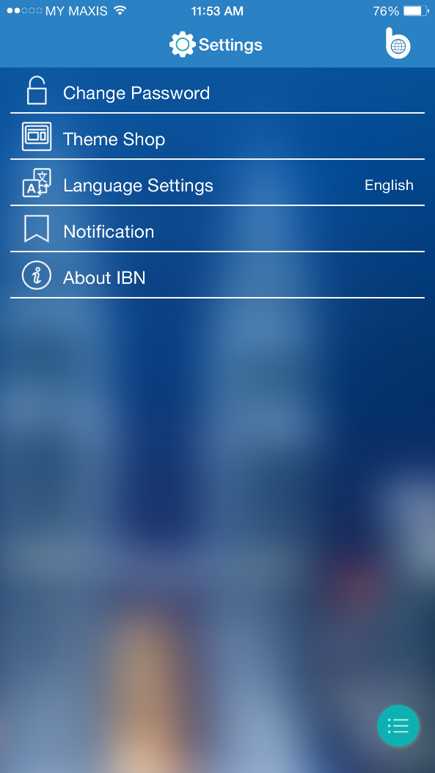
QUICK START
BASICS
SETTINGS
PERSONAL
Change password?
Language Settings?
Settings View
BUSINESS
NETWORK
GROUP
RADAR
You
CONNECTIONS AND ADDING CONNECTIONS
SENDING AND MANAGING REFERRALS
EVENTS
SETTINGS
OTHER FEATURES

Slide 28
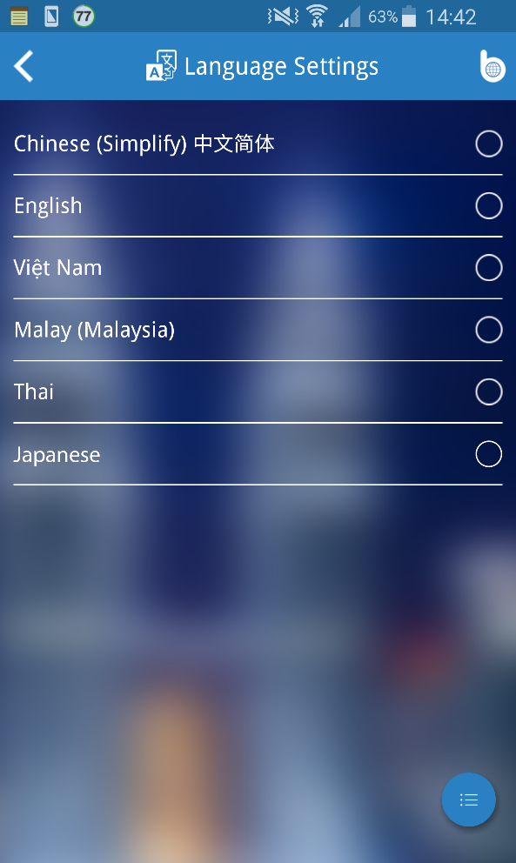
Hi!
Dobrý den!
LANGUAGE SETTINGS
Hi!
Hallo!
Settings View
مرحبا!
नमस्कार!
你好！
สวัสดี!
こんにちは！
Many types of languages for all users.
Hi!
Bonjour!
xin chào！
မင်္ဂလာပါ!
Hej!
Apa Khabar!
Olá!
Hi!
你好！
你好！
안녕하세요!
Hi!
Merhaba!

Slide 29
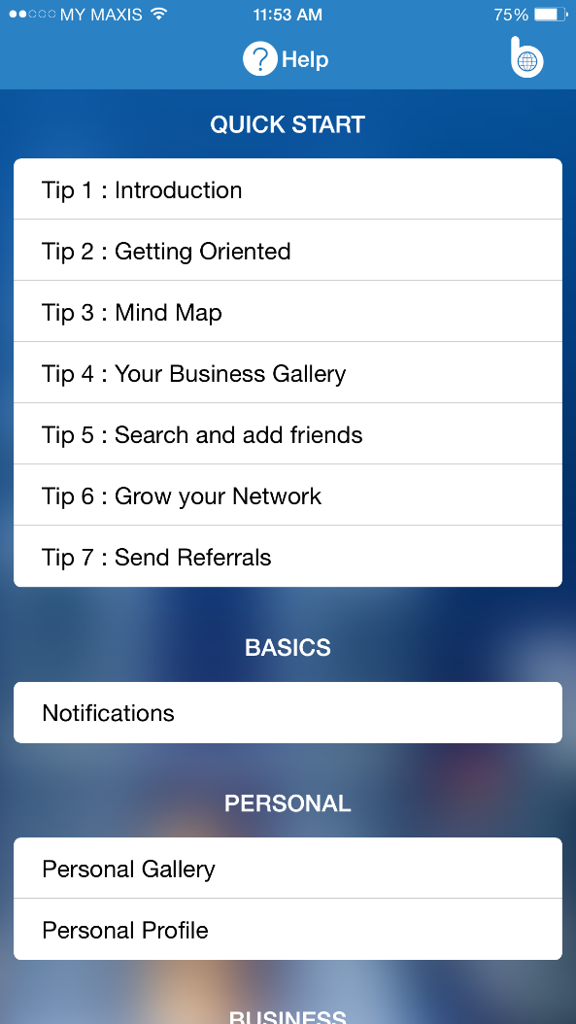
HELP
Help View

Slide 30
QUICK START
BASICS
HELP
PERSONAL
Help View
BUSINESS
NETWORK
GROUP
RADAR
You
CONNECTIONS AND ADDING CONNECTIONS
SENDING AND MANAGING REFERRALS
EVENTS
SETTINGS
OTHER FEATURES

Slide 31
ADD CONNETIONS (INVITE)
By Scan QR Code
Invite people to join IBN
Invite by Link
IBN become more members.
Invite
Add by Contacts
Invite
Invite
Invite by Facebook
Invite
Invite
Invite
Invite
Invite
Invite by Email
Invite
Invite
Invite
You
Invite by Gmail
Invite
Invite
Invite
Invite by SMS
Invite
Invite
… …

Slide 32
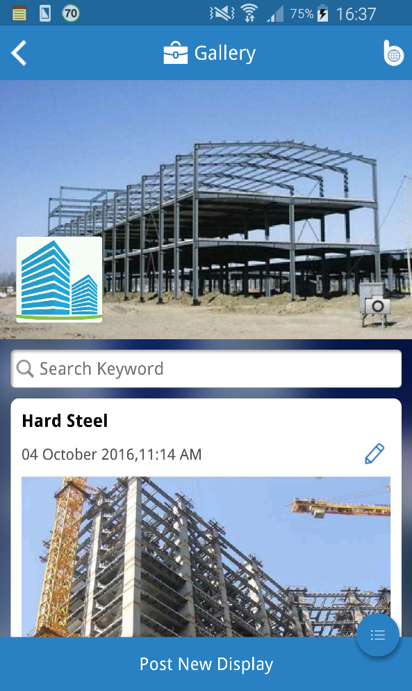
NOTICED!
NOTICED!
HELP
NOTICED!
Help View
NOTICED!
NOTICED!
NOTICED!
NOTICED!
NOTICED!
NOTICED!
You
NOTICED!
NOTICED!
Add New Display

Slide 33
EVENTS
Events View
Notification!
Join the event
Notification!
You
Join the event
Choose
the date.
Notification!
30
Your Group
Join the event
Notification!
Create an Event
Join the event
Notification!
Join the event
New Events
Join the event
Your Business
Notification!
Join the event
Notification!
Join the event
Join the event
Notification!
Notification!
Join the event
Notification!
Join the event
Join the event
Join the event
Join the event
Your Network
Join the event
Notification!
Notification!
Join the event
Join the event
Notification!
Notification!
Notification!
Notification!
Notification!
Notification!

Slide 34
HELP
Help View
END

